Slide 1
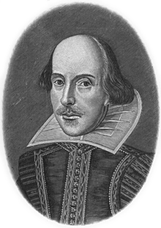
William Shakespeare

Slide 2
About Shakespeare
BORN: April 1564 in Stratford-upon-Avon in central England
He was an English poet, playwright and an actor
People often say that he was the greatest writer in the English language
His plays have been translated into every major living language
People know very little about him

Slide 3
In 1582,when he was 18 years old,he married Anne Hathaway
They had three children
He joined ‘The Lord Chamberlain’s Men’ in 1593
‘The Lords Chamberlain’s Men’-one of England’s most famous acting companies
He stayed with the group,acting and writing until 1599

Slide 4
He continued acting in another theatre,’The Globe’
In his life he wrote 38 plays,154 sonnets, two long narative poems, and a few other verses
1613 he retired
Shakespeare continued to write plays until his death
1616,he died at the age of 52

Slide 5
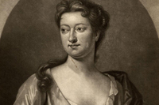
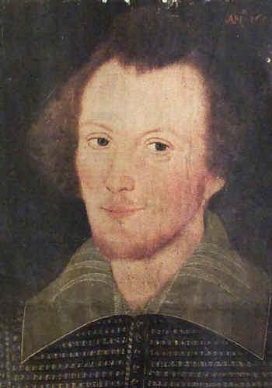
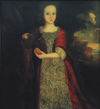
HAMNET SHAKESPEARE
SUSANNA HALL
ANNE HATHAWAY
JUDITH QUINEY

Slide 6
Some famous tragedies
Romeo and Juliet
Titus Andronicus
Julius Caesar
Troilus and Cressida
Hamlet
Othello
King Lear
Antony and Cleopatra

Slide 7
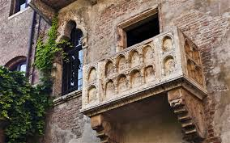
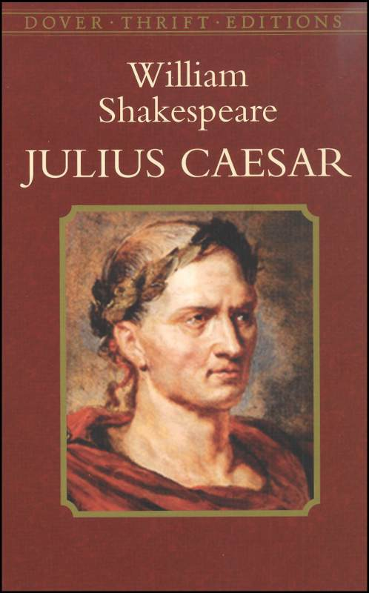
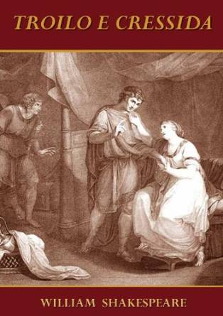

Slide 8
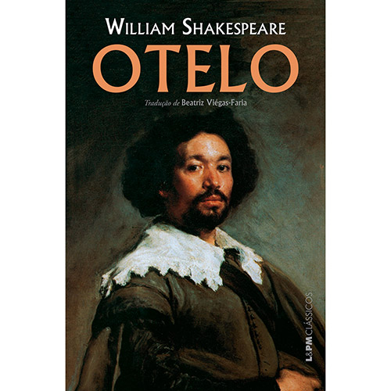
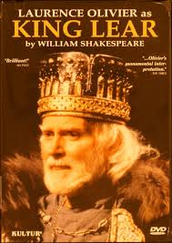
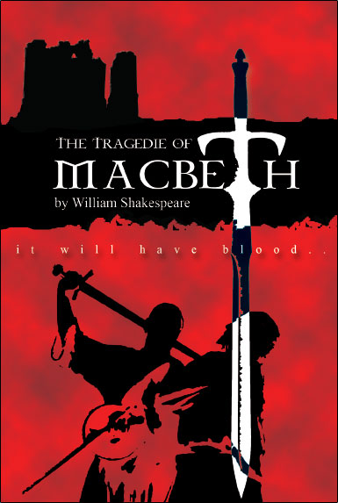
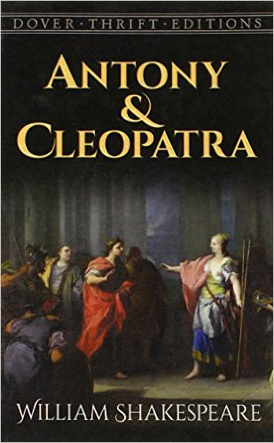

Slide 9
Some famous comedies
Love's Labour's Lost
The Two Gentlemen of Verona
Pericles, Prince of Tyre
Two Noble Kinsmen

Slide 10
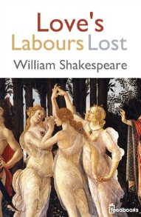
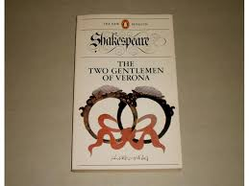
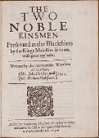

Slide 11
Some famous poems
Venus and Adonis
The Phoenix and the Turtle
Shakespeare's Sonnets

Slide 12
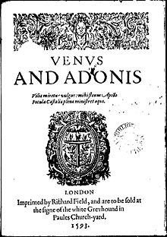
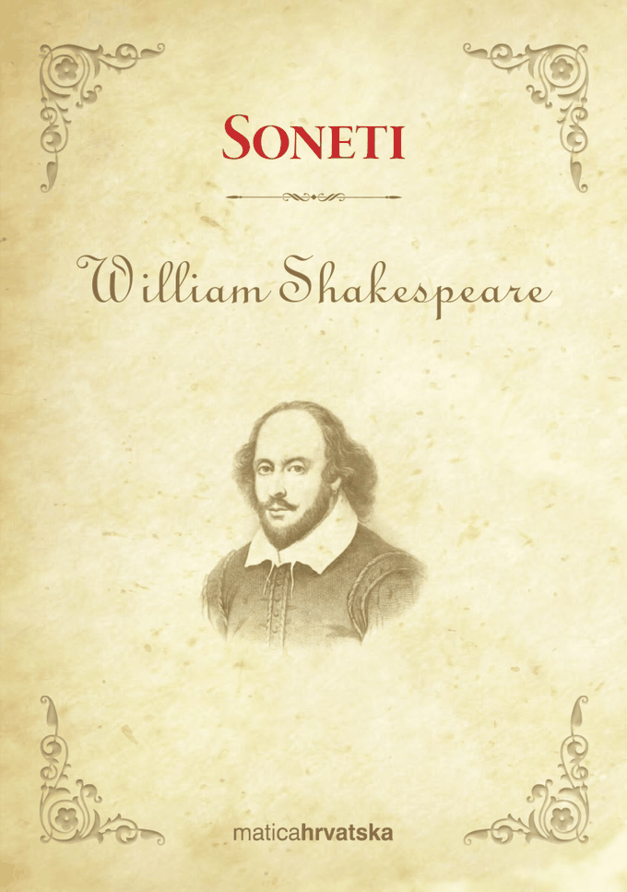
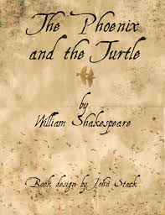

Slide 13
ROMEO & JULIET
One of the most popular Shakespeare’s works
Romeo and Juliet are the main characters in the tragedy
It’s about a big forbidden love
At the end of the story Romeo and Juliet die together
Juliet pretended that she was dead
Romeo saw her and killed himself
When Juliet woke up she saw Romeo dead and killed herself with Romeo’s dagger

Slide 15
HAMLET
Hamlet is a tragedy with a tense action
It’s about a son who lost his father, but his mother married his uncle
In the main body of the story, Hamlet finds out that his father was killed
Everbody tells him that his father died from snake’s poison
He was looking for the truth and at the end he died

Slide 16
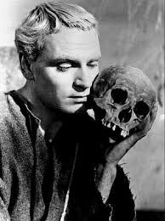

Slide 17
Some things that you didn’t know about W.Shakespeare
1) After the Bible, he is te most quoted author
2) He introduced 3,000 new words in English language
3)He got married at the age of 18 because his 26 years old wife was pregnant
4)He didn’t publish any of his 36 dramas
5)He never gave the text to actors before the drama display

Slide 18
6)He often acted in his own shows
7)His plays were translated into 80 languages
8) There are 80 quality writing his name
9)No one knows the exact date of his birth
10) The original Globe Theatre was destroyed in 1613 during the performance of Shakespeare's play Henry VIII.

Slide 19
PRESENTATION DEVELOPED:
Lucija Trcak
8.A
Elena Rukelj

